Slide 1
TigerGraph and Graph Databases
MLCC LAB exercise 4

Slide 2
What is tigerGraph?

Slide 3
Sign up to tigerGraph

Slide 4
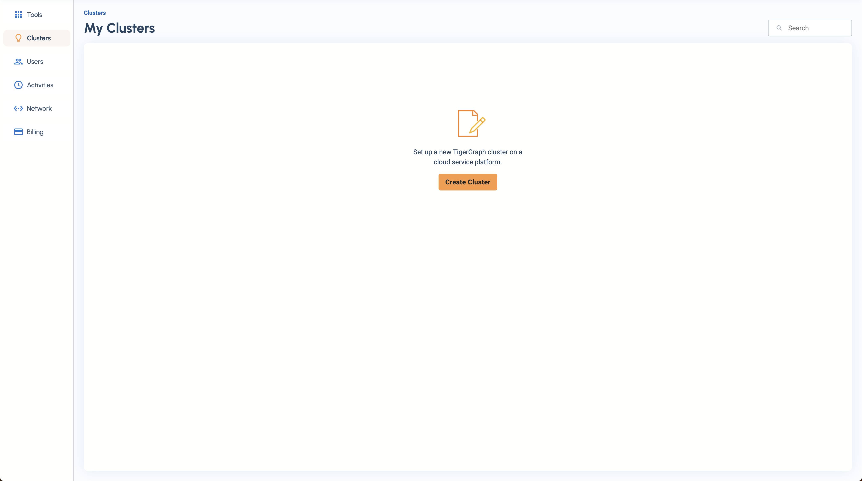
Create a Cluster

Slide 5
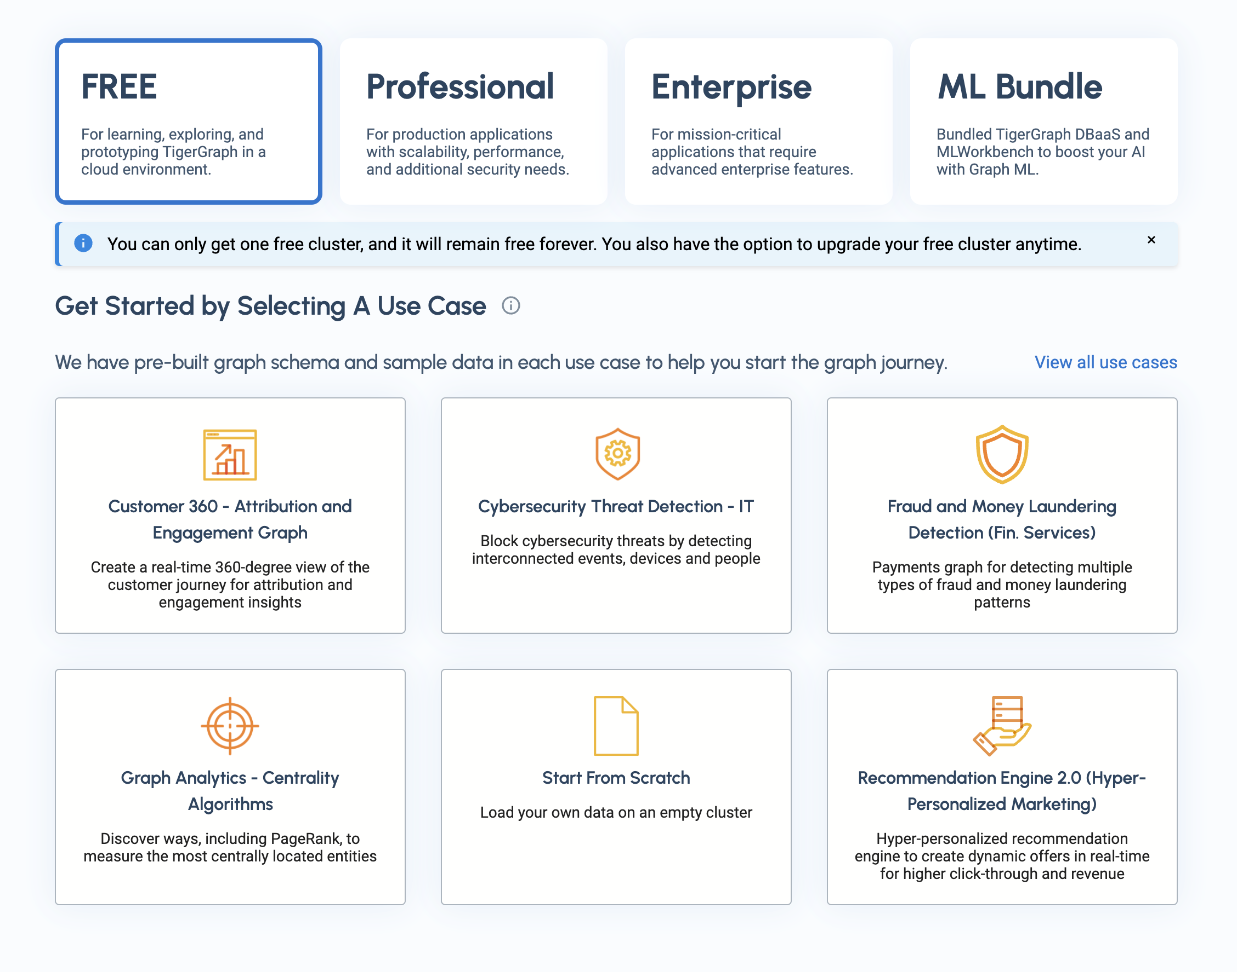
Select Start From Scratch

Slide 6
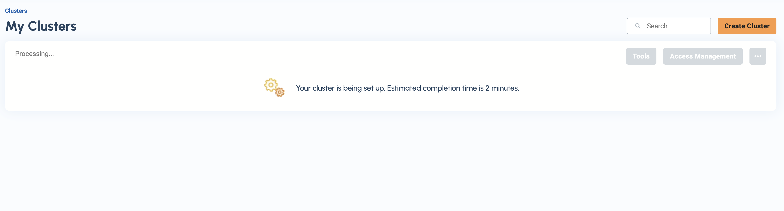
This takes a couple of minuets

Slide 7
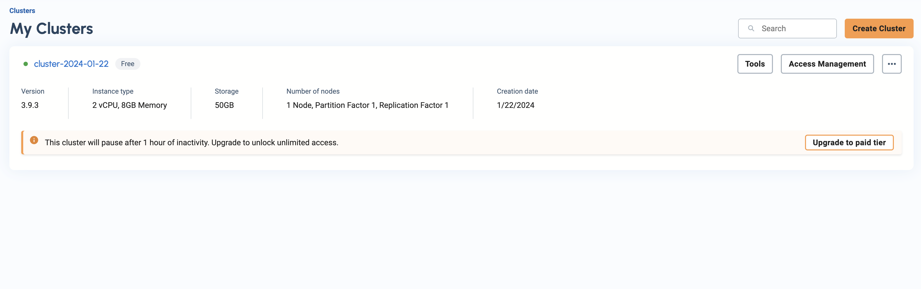
When finished, it should look like this:

Slide 8
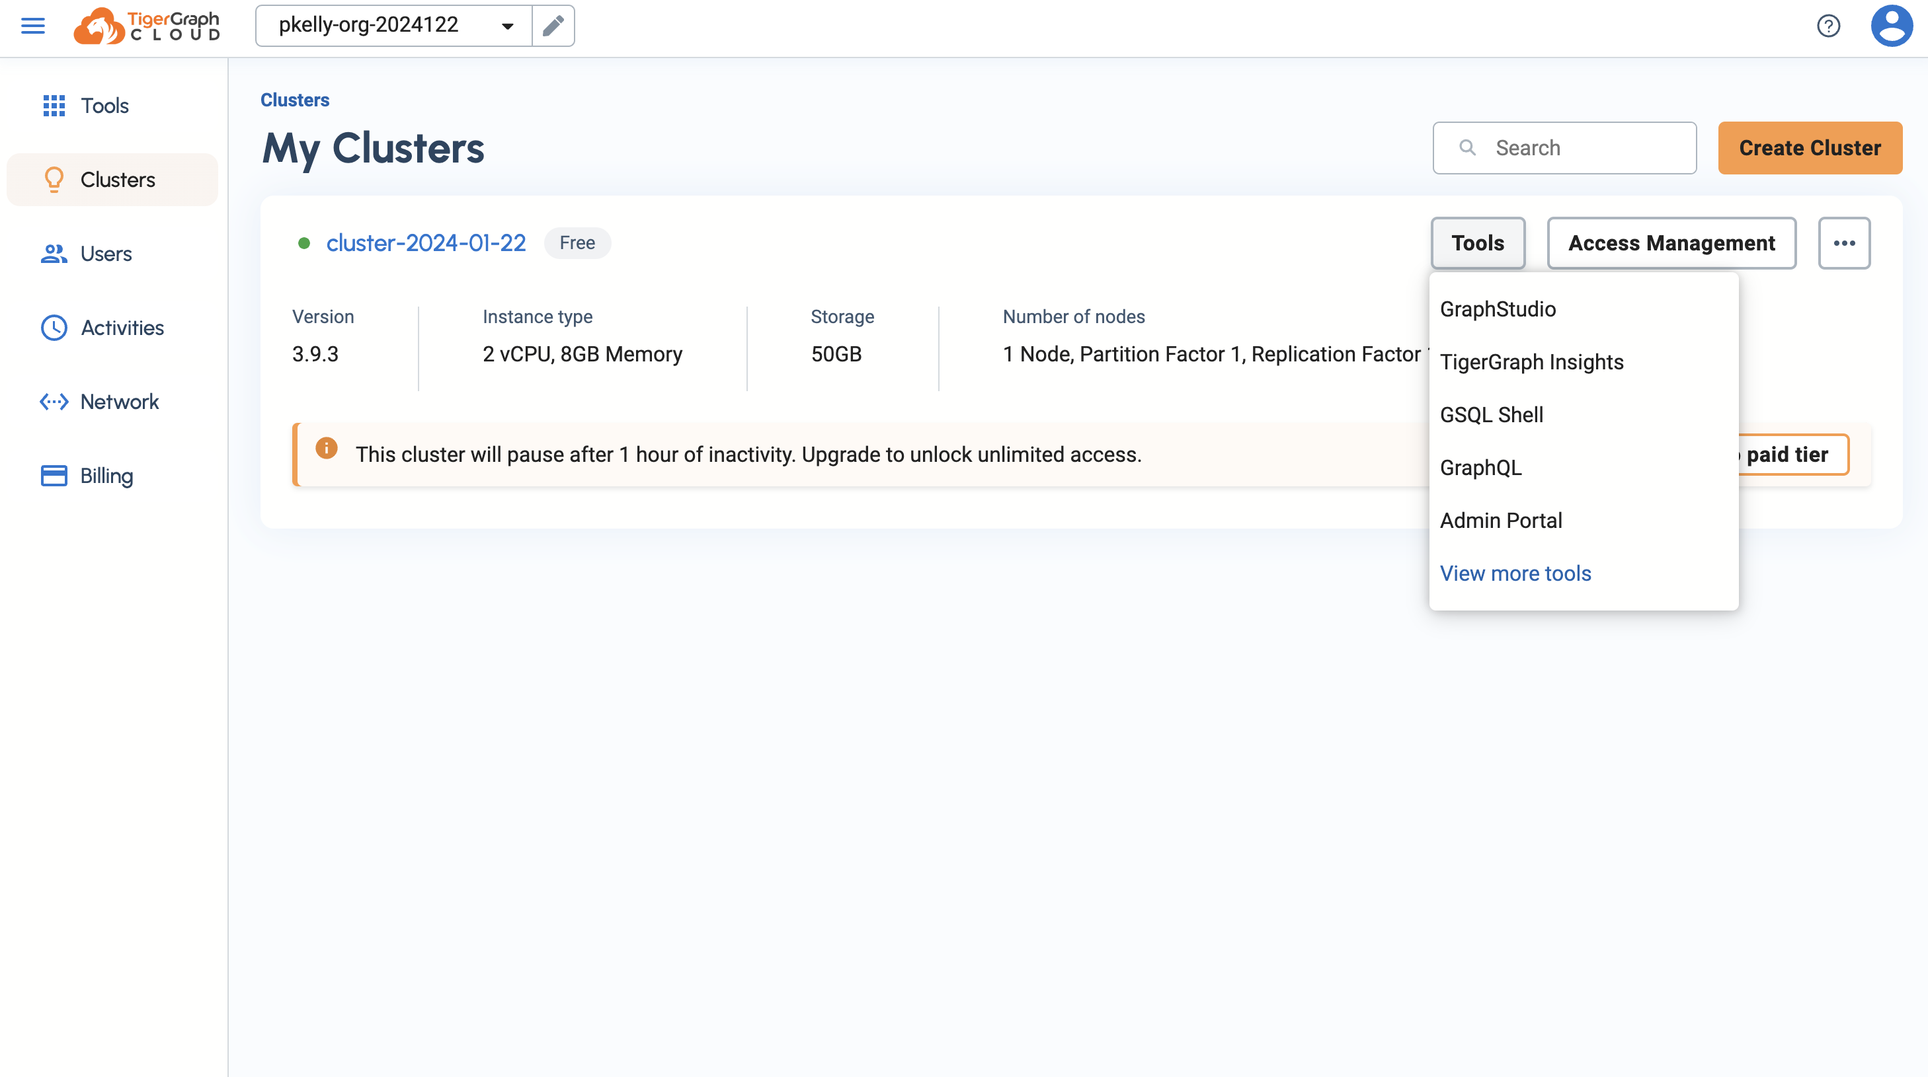
Click ‘Tools’ and then ‘GraphStudio’

Slide 9

Should look something like this

Slide 10

Click ‘Global View’ and then ‘Create New Graph’

Slide 11
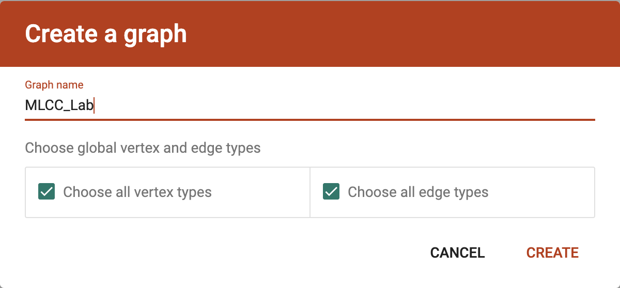
Name and create your graph

Slide 12
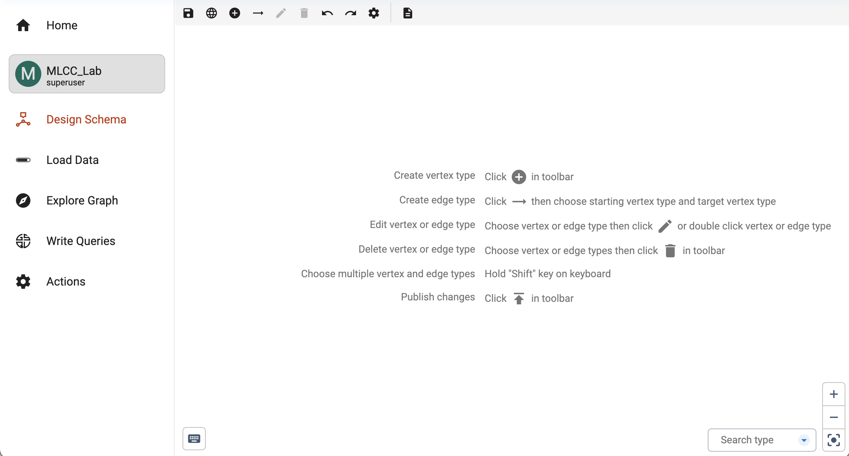
Design a Schema

Slide 13
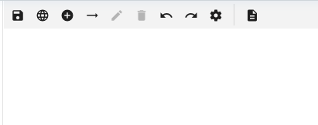
Adding a new Vertex
Click Here

Slide 14
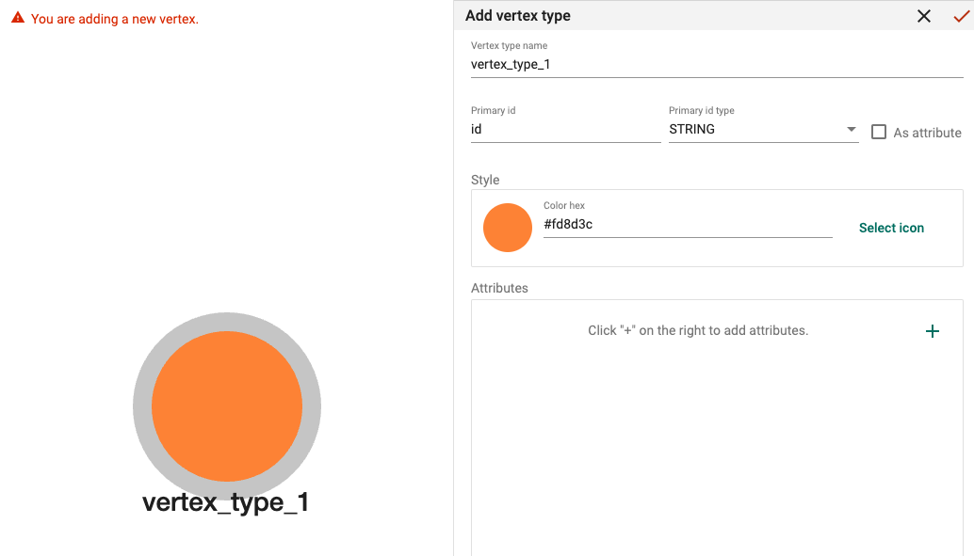
New Vertex Type

Slide 15
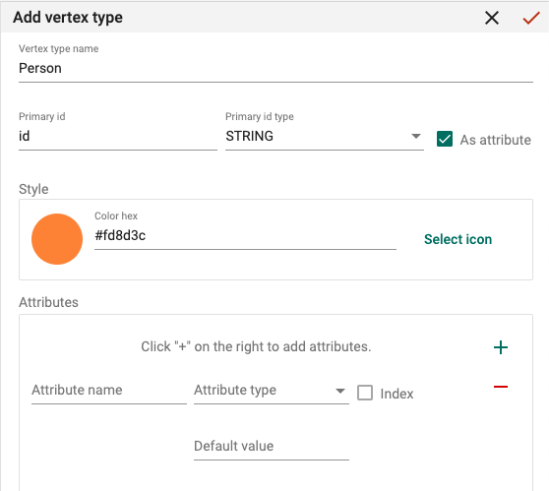
Adding attributes
Set Vertex type name
Set ID as attribute
Add other attributes

Slide 16
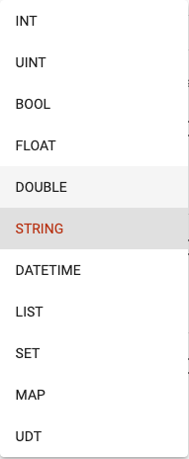
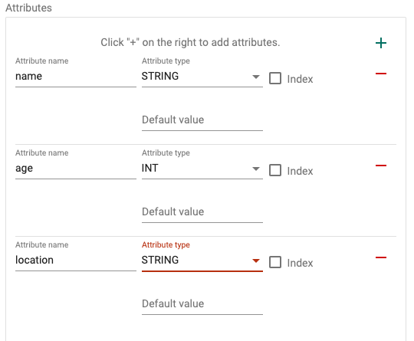
Attribute type

Slide 17
When you are finished

Slide 18
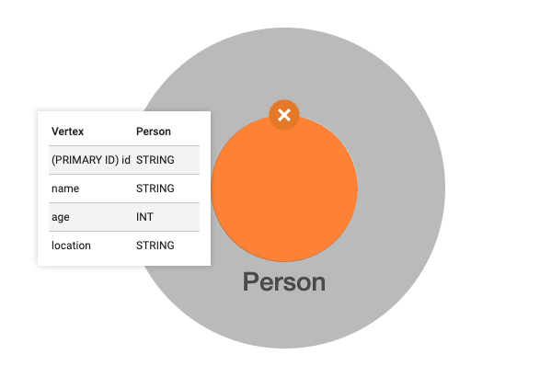
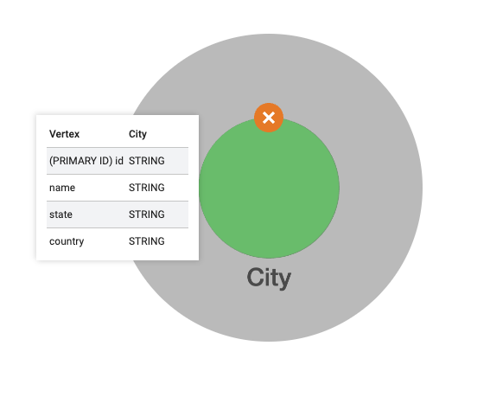
Let’s Make another Vertex

Slide 19
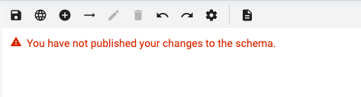
Saving Changes
Click Here

Slide 20
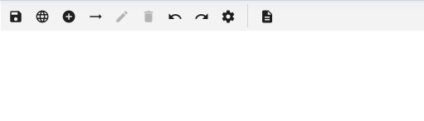
Adding Edges
Click Here

Slide 21
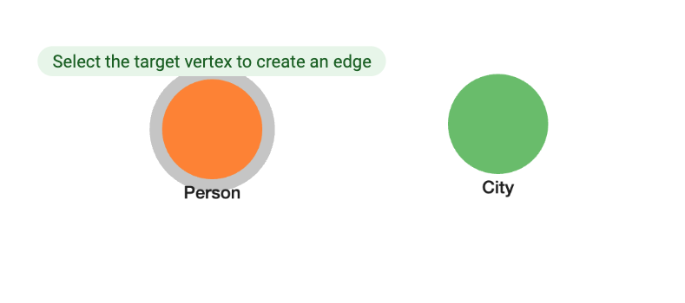
Select the first vertex, then select the target vertex

Slide 22
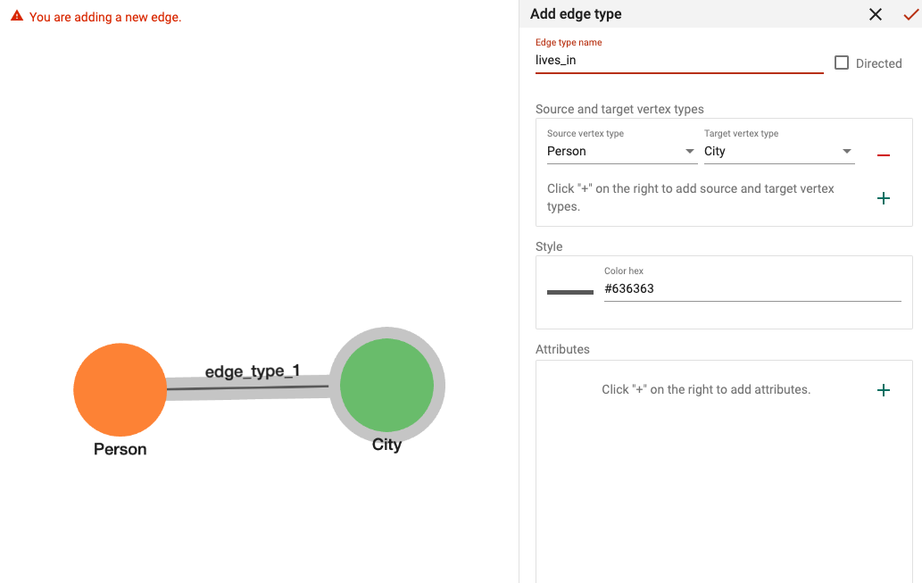
Adding Edge Type

Slide 23
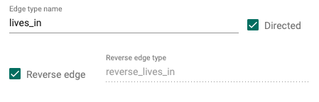
Directed?
Person lives in a city, but a city can not live in a person. Therefore, the edge is directed.
Reverse allows for data flow the opposite way, if needed.

Slide 24
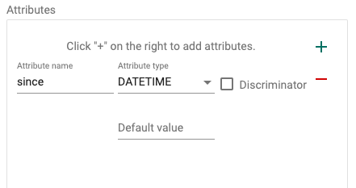
Edge Attributes
Edges can also have attributes

Slide 25
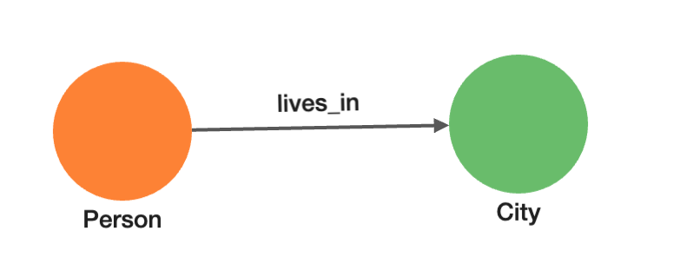
Now we have an edge between our vertices

Slide 26
Saving Changes
Click Here

Slide 27
Pause to build our graph based on the data from the book.
Add link to data

Slide 28
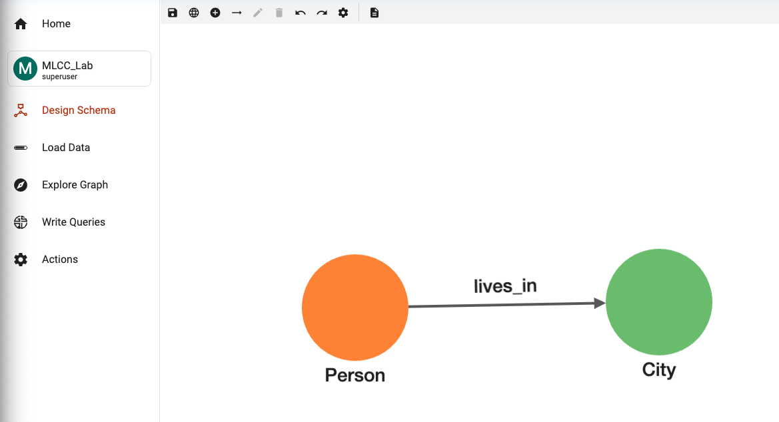
Manually adding an instance
Click Here

Slide 29

Edit mode
Click Here

Slide 30
Add new vertex instance
Click Here

Slide 31
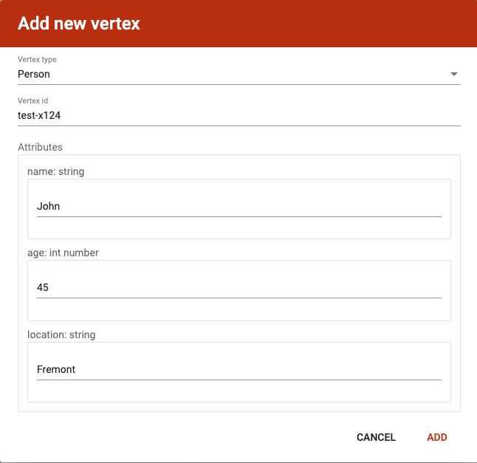
Choosing types and adding attributes

Slide 32
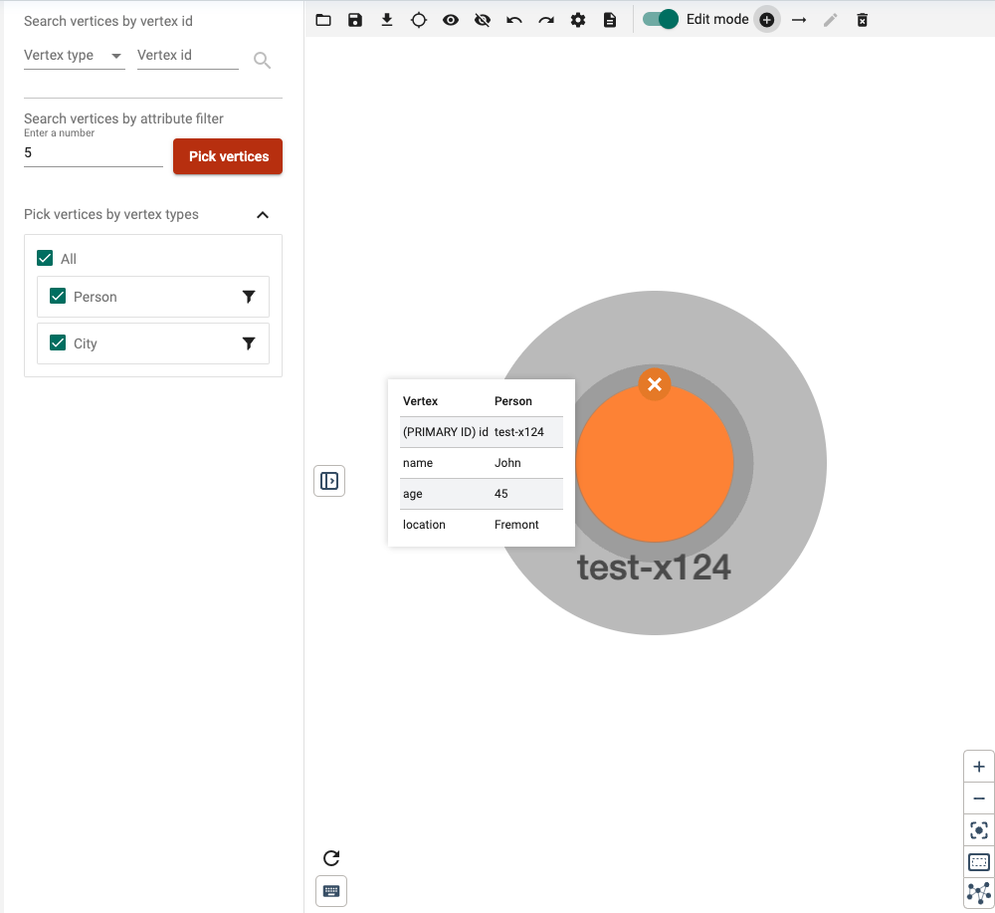
Add another vertex instance

Slide 33
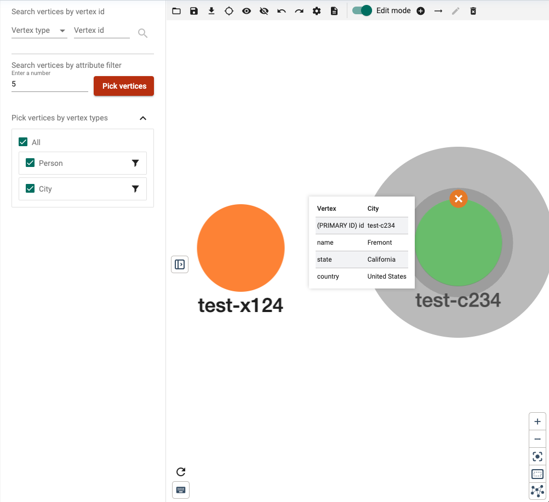
Look at our two instances! Once person, once city

Slide 34
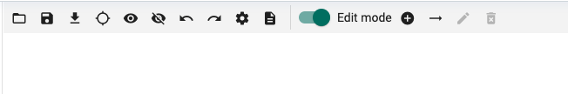
Adding an Edge instance
Click Here

Slide 35
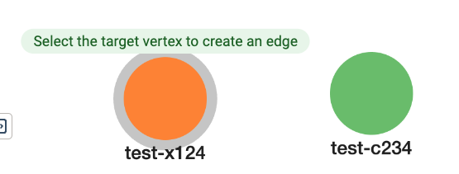
Select first vertex, then select the target vertex

Slide 36
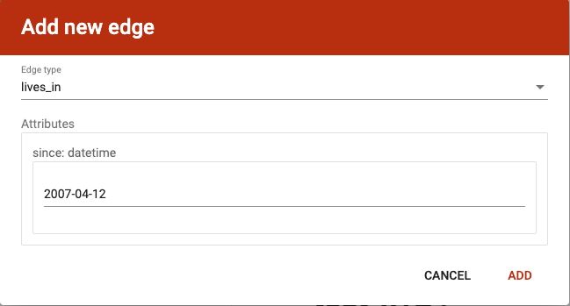
Adding edge instance attributes (if any)

Slide 37
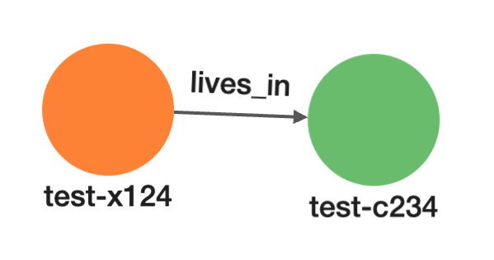
Our manual data instance

Slide 38
Pause to build our manual instance based on the data from the book???
Add link to data

Slide 39
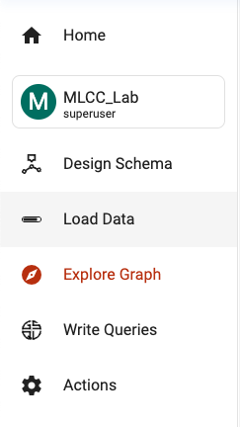
GSQL queries
Click Here

Slide 40
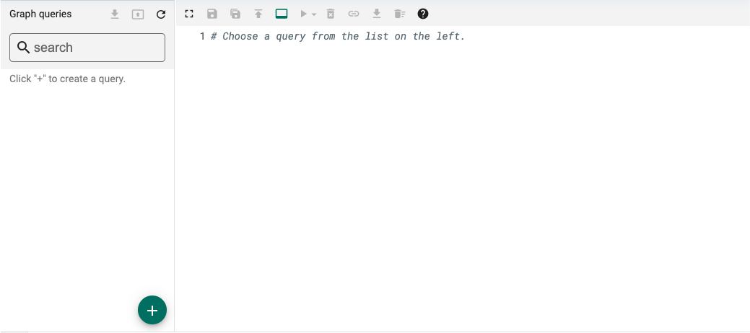
Adding a new query
Click Here

Slide 41
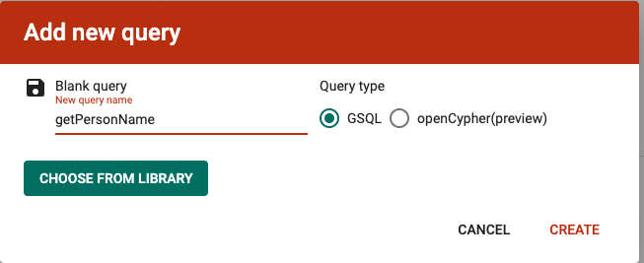
Query to get person name based on id

Slide 42
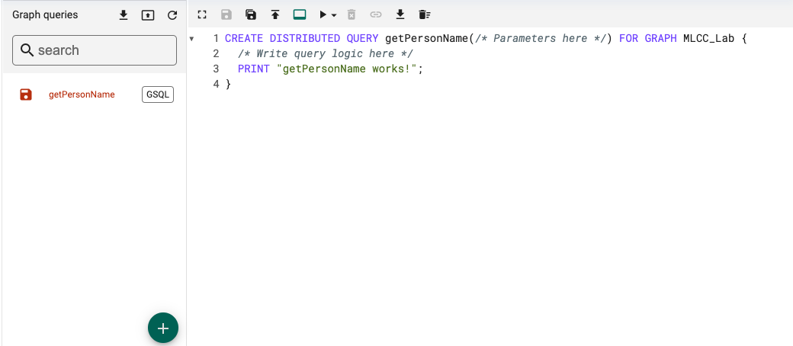
We should get something like this:

Slide 43
Writing Logic

